Slide 1
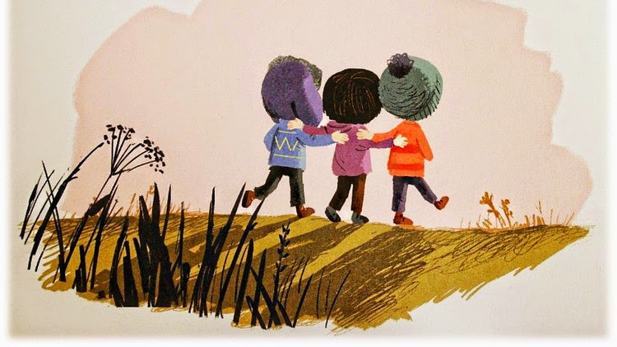
LO: To write the end to my story

Slide 2
LO: To write the ending to my story
SC: I can..
Use my plan
Solve the problem in my story
Edit my writing
Write a few sentences to solve my problem
Extend my sentences using conjunctions and descriptive language
Think about the impact on the reader. Can my word choices make the reader laugh, feel sad or happy?

Slide 3

Warm up your writer’s brain.
Can you help me edit my writing?
Birt feelt confused becase he didn’t understand wi his frend wantit to play wif someone new He walked slowle to his distressed, brown hows and poot his box on the floor. a sudden anger filled Birt’s head. Within seconds he had destroyed his favourite cardboard box. A single tear ran down his flushed, red faice as he stomped inside angrily

Slide 4

How many did you spot?
felt because why friend wanted
Birt feelt confused becase he didn’t understand wi his frend wantit to
with slowly house
play wif someone new. He walked slowle to his distressed, brown hows
put A l
and poot his box on the floor. a sudden anger filLed Birt’s head. Within
ran
seconds, he had destroyedhis favourite cardboard box. A single tear run
d face
Down his freckled, red faice as he stomped inside angrily.

Slide 5
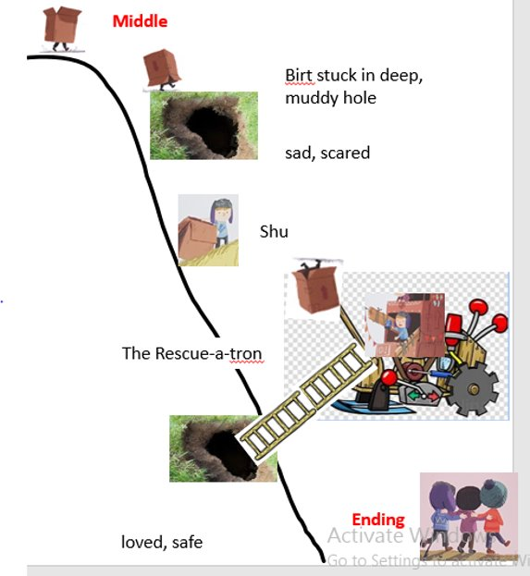
Suddenly Etho and Birt both heard a friendly voice calling. It was Shu!
Birt and Etho both felt a sudden turn in their tummies. Was it nerves or excitement? There was a loud rumble as a long, shiny ladder poked it’s way into the hole. It was the new and improved version of the Rescure-a-tron. The boys cheered happily as they grabbed hold of the ladder. Shu carefully pulled the boys out of the hole and lowered them onto the soft, green grass.

Slide 6
Find your editing pen!
Editing tool kit: What are we double checking?
Does it makes sense?
Have I got all my full stops?
Have I got all my capital letters?
Check spellings – You can use a word mat to help you
Challenge – Can you ‘up level’ anything? Make it even better.

Slide 7

You should be so proud of your self!

