Slide 1


Handwriting Workshop
Hassocks Infant School
✮ Explore ✮ Respect ✮ Flourish

Slide 2
Handwriting supports reading and spelling!
Research shows developing cursive handwriting supports children with dyslexia
Encourages creativity
We live in a digital age so why teach handwriting?
Research shows developing handwriting skills supports several cognitive areas
Key form of communication
Encourages ownership – a sense of writing style
Evidence to show that it supports memory
Supports motor skills development
Hassocks Infant School
✮ Explore ✮ Respect ✮ Flourish

Slide 3
The Primary National Curriculum (2014) states children should leave primary school with the ability to produce fluent, legible and, eventually, speedy join-up handwriting, and to understand the different forms of handwriting used for different purposes.
Hassocks Infant School
✮ Explore ✮ Respect ✮ Flourish
Notes:
We believe that our approach supports children to build the foundation to leave primary school successfully doing this.

Slide 4
Developmental Stages of Writing
When children are at the pre-literate stage they may be…
creating scribbles
creating some symbolic marks
making directional scribbles
forming symbolic/mock letters
INSERT PICTURES
Hassocks Infant School
✮ Explore ✮ Respect ✮ Flourish
Notes:
Handwriting and writing intrinsically linked – let’s look at the stages on writing to understand why

Slide 5
Developmental Stages of Writing
When children are at the emergent stage they may be…
creating strings of letters
creating groups of letters
labelling pictures
writing some print letters
INSERT PICTURS
Hassocks Infant School
✮ Explore ✮ Respect ✮ Flourish

Slide 6
Developmental Stages of Writing
When children are at the transitional stage they may be…
writing letters and word representations
write first and last letter representations
begin to write the middle letter sounds
INSERT PICTURES
Hassocks Infant School
✮ Explore ✮ Respect ✮ Flourish

Slide 7
Developmental Stages of Writing
When children are at the fluent stage they will be…
phrase writing
sentence writing
INSERT PICTURES
Hassocks Infant School
✮ Explore ✮ Respect ✮ Flourish

Slide 8
The Teaching of Handwriting
We can see from the stages of writing development, it is vital for us to provide opportunities for our children to develop their handwriting.
At Hassocks Infant School we have a planned approach to the teaching of handwriting.
So, how do we go about doing this?
INSERT PICTURS OF HANDWRITING BE TAUGHT/IN THE ENVIRONEMNT
Hassocks Infant School
✮ Explore ✮ Respect ✮ Flourish

Slide 9
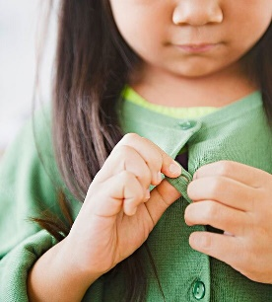
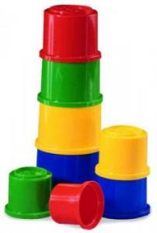
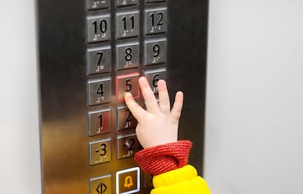
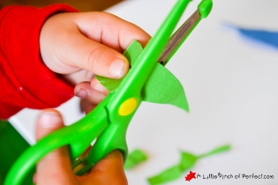



Ongoing Provision: Fine Motor Development
What are fine motor skills?
Why are fine motor skills important ?
Fine motor skills are essential for performing everyday skills.
Fine motor skills are the ability to make movements using the small muscles in our hands and wrists.
Hassocks Infant School
✮ Explore ✮ Respect ✮ Flourish
Notes:
We will start by sharing our ongoing provision
Fine motor skills
Pen Grip
Fine motor skills refer to the coordination between small muscles, like those of the hands and fingers, with the eyes. Fine motor skills involve the small muscles of the body that enable such functions as writing, grasping small objects and fastening clothing. They involve strength, fine motor control, and dexterity.
e.g. getting dressed, brushing teeth, holding a pencil, drawing pictures and writing, stacking blocks and stringing beads, using scissors, rulers and other tools

Slide 10
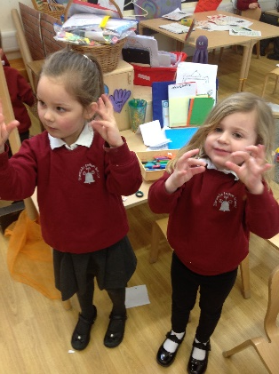
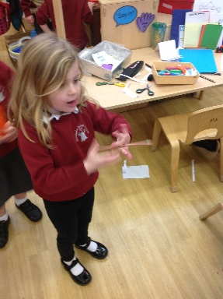
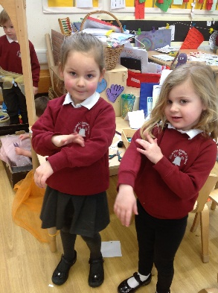



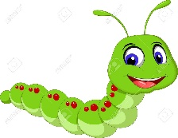
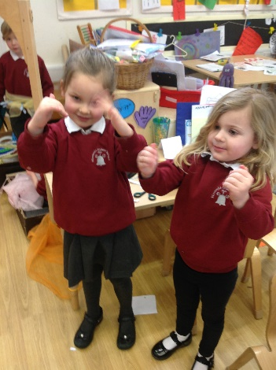
Ongoing Provision: Hand and body warm-ups
Finger stretches
Helicopter twirls
Fishing hook
Fireworks
Take a bow
Quack quack fingers
Crawling caterpillar
Play the piano
Hassocks Infant School
✮ Explore ✮ Respect ✮ Flourish

Slide 11
Ongoing Provision: Pen Grip
The Tripod Grip
1) Grip the pencil with your index finger and thumb with the nib pointing away.
2) With your free hand, spin the pencil from underneath.
3) Use your middle finger to support the underside of the pencil.
INSERT PICTURE OF CHILD’S GRIP
Hassocks Infant School
✮ Explore ✮ Respect ✮ Flourish

Slide 12
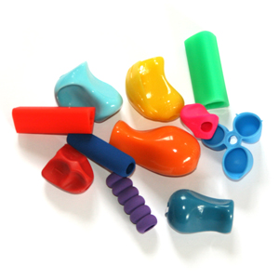
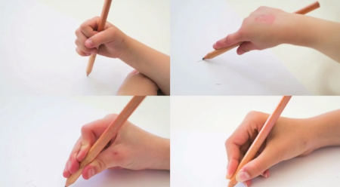
Ongoing Provision: Pen Grip Support
Recognise all children are unique and may be at a different stages of their grip development
Continue with fine motor development activities (we will share activities later)
Pen/pencil grips (lots of types)
INSERT PICTURE
Hassocks Infant School
✮ Explore ✮ Respect ✮ Flourish

Slide 13
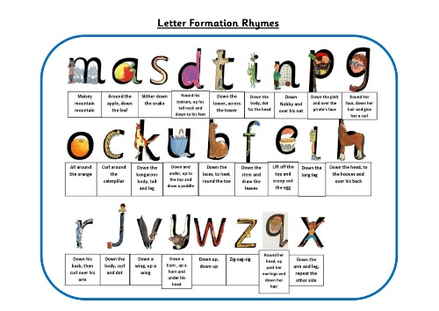

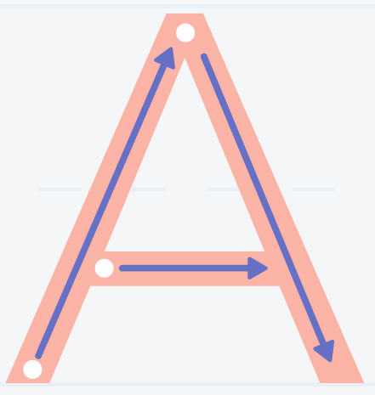
Reception
Early in the Autumn Term, pre cursive patterns will be taught e.g. circles and spirals, lines and diagonals, jellies and zig-zags, loopies and waves.
From Autumn 2 and during the spring term, children will be taught the formation of letters as printed letters.
From summer term children will be taught pre-cursive letters: i, l, t, u, w, e, c, o, a, b, n, m, h, j, y, g, q, d, p, k, v, s, r, f, x, z
(Based on ongoing assessment, these may be introduced sooner)
The teaching of capital letters will be ongoing throughout the Spring and Summer terms.
Hassocks Infant School
✮ Explore ✮ Respect ✮ Flourish
Notes:
The National Handwriting Association believes…
it is important that a child’s handwriting becomes a skill that requires little effort and thought, so that creative and physical energy can be focused on the content of writing, rather than upon the act. Consequently, teaching correct letter formation from an early stage will support to make handwriting an automatic process that does not interfere with creative and mental thinking.

Slide 14
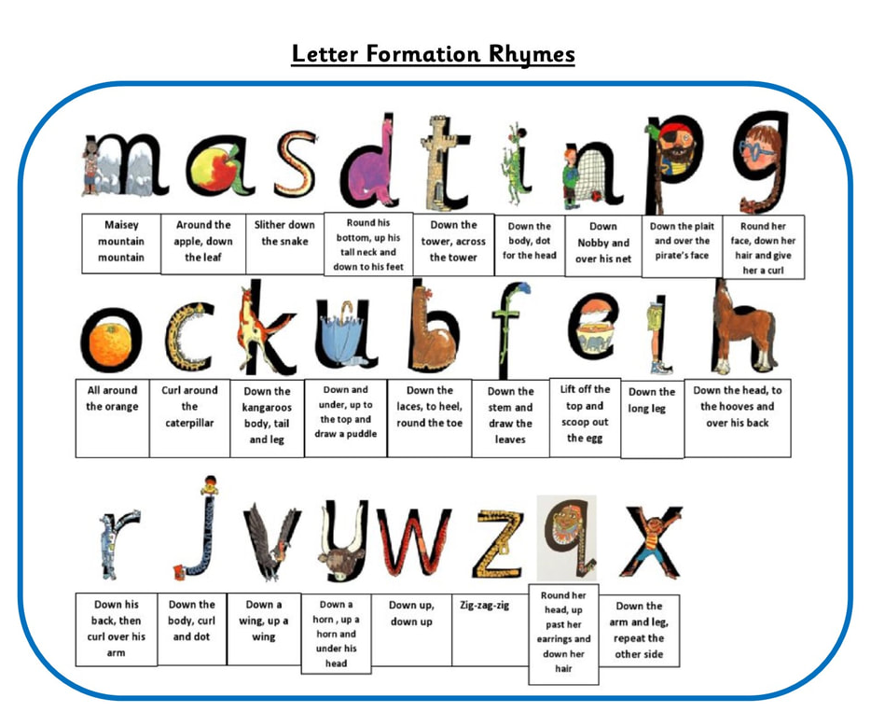
Reception
i, l, t, u, w, e, c, o, a, b, n, m, h, j, y, g, q, d, p, k, v, s, r, f, x, z
Using cursive letters will take lots of practice. It continues to be a focus in Year 1 and 2.
Hassocks Infant School
✮ Explore ✮ Respect ✮ Flourish

Slide 15

The teaching of the formation of numbers will be ongoing to build on and consolidate learning from Reception.
In addition to this, the formation of punctuation, maths and other symbols will be taught.
Year 1
The pre-cursive letters taught in reception will be retaught and refined to ensure they are embedded for Year 2.
The teaching of capital letters will be ongoing to build on consolidate learning from Reception.
i, l, t, u, w, e, c, o, a, b, n, m, h, j, y, g, q, d, p, k, v, s, r, f, x, z
Hassocks Infant School
✮ Explore ✮ Respect ✮ Flourish

Slide 16
Year 2
The focus will be on developing fluency and speed of children’s handwriting through regular practice.
What will be taught/covered?
Letter families
High frequency words
Dictation exercises
Joining letters diagonally
    acdehlmn
Joining letters horizontally
svwor
Difficult joins joining
    letters and words to a from f, k, w, s and z
INSERT PICTURE OF YEAR TO WRITING
Hassocks Infant School
✮ Explore ✮ Respect ✮ Flourish

Slide 17
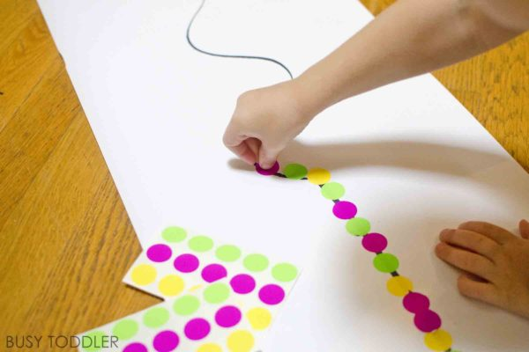
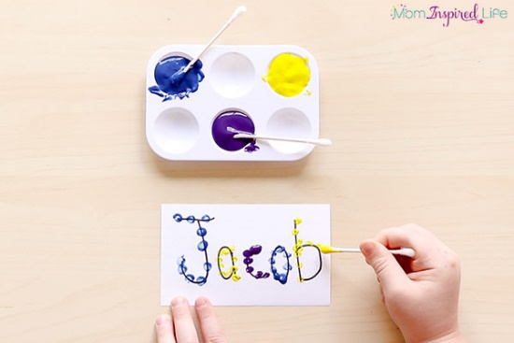
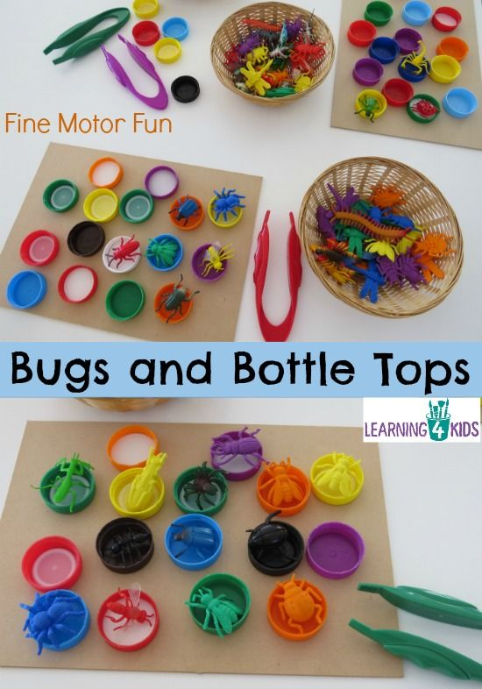
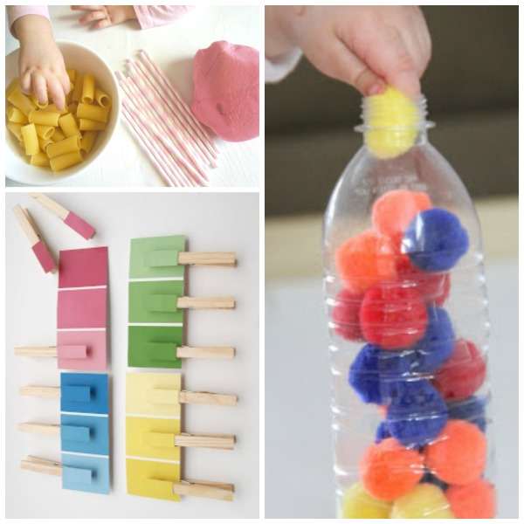
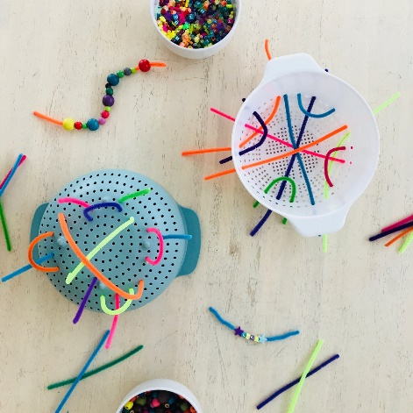
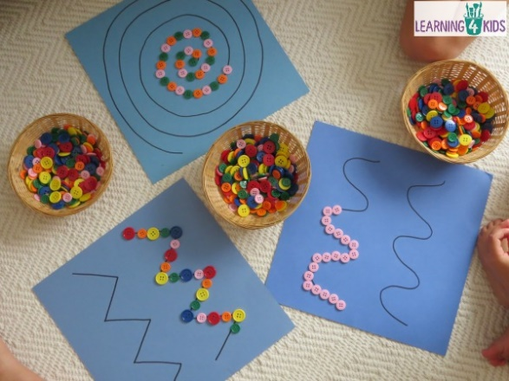
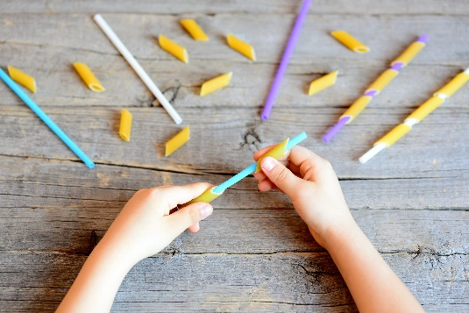
How can you support your child with their handwriting at home?
Hassocks Infant School
✮ Explore ✮ Respect ✮ Flourish

Slide 18




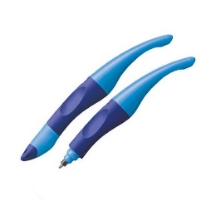
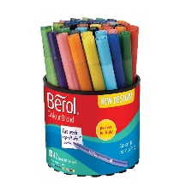


How can you support at home?
Air writing!
Some children like lines!
Say the rhymes
Different size and colour pens/pencils!
Visual prompts
Coloured paper
Pen grips
i, l, t, u, w, e, c, o, a, b, n, m, h, j, y, g, q, d, p, k, v, s, r, f, x, z
Modelling
Hassocks Infant School
✮ Explore ✮ Respect ✮ Flourish

Slide 19


How can you support at home?
Lots of praise!

Slide 20

Questions
Hassocks Infant School
✮ Explore ✮ Respect ✮ Flourish

